Slide 1


Inheritance

Slide 2
Contents
Inheritance
  Problem definition
  Strategies
Inheritance lesson examples with explanation
  Implementing Inheritance: Start
  Implementing Inheritance: SINGLE TABLE
  Implementing Inheritance: JOINED
  Implementing Inheritance: TABLE PER CLASS
  Implementing Inheritance: Polymorphic Queries
  Implementing Inheritance: @MappedSuperclass

Slide 3
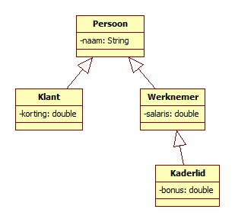
Problem definition
How do you deal with this class diagram? How do you implement this inheritance tree in JPA?

Slide 4
Strategies
JPA foresees 3 inheritance strategies:
  One table for all classes in the hierarchy cfr. "modeling by supertype"
  A table per class with interrelationships
  A table per concrete class without interrelationships
  Cfr. "model by subtype" but also with a table for the supertype if it is not abstract
  1 table per direct subclass if the superclass is not an Entity
  These are implemented with the annotation:
@Inheritance with the attribute strategy with possibilities
    SINGLE_TABLE (default)
    JOINED
    TABLE_PER_CLASS
@MappedSuperclass: if the Superclass is not an Entity

Slide 5
Implementing inheritance:
START

Slide 6
Content
This presentation will guide you through the implementation of inheritance in a Spring Data JPA project.
Follow these instructions carefully and you will learn what to do and how.
The project that came with this item only serves in case you fail to make it yourself. It is best to use the (tele)coaching in that case...
Good luck!

Slide 7
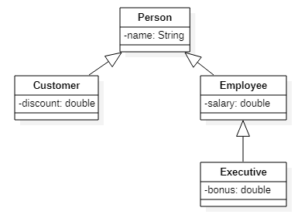
Implementing the example: Inheritance
Step 1: Download and upzip the startproject
  Rename this project and put it in the corresponding folder on GitHub
  Open the project in IntelliJ
Step 2: Create Entity "Person", "Customer", "Employee" and "Executive"
  See presentation 3 JPA, keyword queries and JPQL to know how to create an entity. Complete the entities with attributes as in this UML schema. Generate the no-arg constructor and getters and setters
  Also encode the inheritance between the different entities
    Tip: use "extends"
  Complete / change the entities according to the chosen strategy
    SINGLE_TABLE
    JOINED
    TABLE_PER_CLASS

Slide 8
Inheritance strategy:
SINGLE_TABLE

Slide 9
Change Person.java for SINGLE_TABLE implementation
@Inheritance(strategy = InheritanceType.SINGLE_TABLE)
@Entity
public class Person {
@Id
@GeneratedValue(strategy = GenerationType.AUTO)
private Long id;
private String name;
….
}

Slide 10
Change Customer.java for SINGLE_TABLE implementation
@Entity
public class Customer extends Person {
private double discount;
public Customer () {
}
public double getDiscount () {
return discount;
}
public void setDiscount (double discount) {
this. discount = discount;
}
} //no attribute Id in this Entity because this is inherited from Person

Slide 11
Change Employee.java for SINGLE_TABLE implementation
@Entity
public class Employee extends Person {
private double salary;
public Employee () {
}
public double getSalary() {
return salary;
}
public void setSalary(double salary) {
this. salary = salary;
}
}//no attribute Id in this Entity because this is inherited from Person

Slide 12
Change Executive .java for SINGLE_TABLE implementation
@Entity
public class Executive extends Employee {
private double bonus;
public Executive () {
}
public double getBonus() {
return bonus;
}
public void setBonus(double bonus) {
this.bonus = bonus;
}
} //no attribute Id in this Entity because this is inherited from Person

Slide 13
Implementing the example : Inheritance
Step 3: Create repository for the entity "Person"
  See presentation 3 JPA, keyword queries and JPQL to know how to do this
  Via polymorphism (declare attribute as Person but instantiate as one of the subclasses) it is sufficient to create only PersonRepository (Customer Repository, EmployeeRepository and ExecutiveRepository are NOT necessary)
Step 4: Create PersonController
  See presentation 0a MVC with Spring and Thymeleaf to know how to do this
  => PersonController
    has an association with Person Repository
    contains the necessary methods to create the
    different objects and redirect to the different pages

Slide 14
Step 4: Create PersonController
Now create the PersonController:
  See presentation 0a MVC with Spring and Thymeleaf to know how to do this
  Make an association with PersonRepository
  Create the following methods:
    Method to show the addPerson page where you can enter the details (name) of a new Person
    Method to, after forwarding the data of the addPerson page, create a new Person object with this data, save this person in the database and then show the index page
    Method to show the addCustomer page where you can enter the details (name, discount) of a new Customer
    Method to, after forwarding the data of the addCustomer page, create a new Customer object with this data, save this customer in the database and then show the index page
    Method to show the addEmployee page where you can enter the details (name, salary) of a new Employee
    Method to, after forwarding the data of the addEmployee page, create a new Employee object with this data, save this employee in the database and then show the index page
    Method to show the addExecutive page where you can enter the details (name, salary, bonus) of a new executive
    Method to, after forwarding the data from the addExecutive page, create a new Executive object with this data, save this executive in the database and then show the index page

Slide 15
Step 4: Create PersonController: code
@Controller
public class PersonController {
private PersonRepository personRepository;
public PersonController(PersonRepository personRepository) {
this.personRepository = personRepository;
}
@RequestMapping("/")
public String index() {
return "index";
}
@RequestMapping("/addPerson")
public String addPerson() {
return "addPerson";
}
@RequestMapping("/processAddPerson")
public String processAddPerson(Model model, HttpServletRequest request) {
String name = request.getParameter("name");
PERSON person = new Person();
PERSON.setName(name);
PERSONRepository.save(person);
return "index";
}
@RequestMapping("/addCustomer")
public String addCustomer() {
return "addCustomer";
}
@RequestMapping("/processAddCustomer")
public String processAddCustomer(Model model, HttpServletRequest request) {
String name = request.getParameter("name");
double discount = Double.parseDouble(request.getParameter(“discount"));
Customer customer = new Customer();
customer.setName(name);
customer.setDiscount(discount);
personRepository.save(customer);
return "index";
}

Slide 16
Step 4: Create PersonController: code (continuation)
@RequestMapping("/addEmployee")
public String addEmployee () {
return "addEmployee";
}
@RequestMapping("/processAddEmployee")
public String processAddEmployee (Model model, HttpServletRequest request) {
String NAME = request.getParameter("name");
double salary = Double.parseDouble(request.getParameter("salary"));
EMPLOYEE employee = new Employee ();
EMPLOYEE. setName(name);
EMPLOYEE.setSalary(salary);
PERSONRepository.save(employee);
return "index";
}
@RequestMapping("/addExecutive")
public String addExecutive () {
return "addExecutive";
}
@RequestMapping("/processAddExecutive")
public String processAddExecutive (Model model, HttpServletRequest request) {
String name = request.getParameter("name");
double salary = Double.parseDouble(request.getParameter("salary"));
double bonus = Double.parseDouble(request.getParameter("bonus"));
Executive executive = new Executive();
executive.setName (name);
executive.setSalary (salary);
executive.setBonus(bonus);
personRepository.save(executive);
return "index";
}
}

Slide 17
Implementing the example: Inheritance
Step 5: create user interface:
  index.html
  addPerson.html
  addCustomer.html
  addEmployee.html
  addExecutive.html

Slide 18
Step 5: Create user interface index.html
Now we are left with creating a user interface. Create a new Thymeleaf HTML file index.html so that new people/customers/employees/executives can be registered:
<body>
<p></p><a href="/addPerson">Add a person </a></p>
<p><a href="/addCustomer">Add a customer</a></p>
<p><a href="/addEmployee">Add an employee</a></p>
<p><a href="/addExecutive">Add an executive</a></p>
</body>

Slide 19
Step 5: Create user interface addPerson.html
Now the pages addPerson.html, addCustomer.html, addEmployee.html and addExecutive.html still need to be added. We start with the body of addPerson.html:
<body>
<h1>Create Person</h1>
<form action="/processAddPerson" method="post">
<p>
<label for="name">Name:</label>
<input type="text" name="name" id="name">
</p>
<p>
<input type="submit" value="Save" name="save">
</p>
</form>
</body>

Slide 20
Step 5: Create user interface addCustomer.html
We work out the body of addCustomer.html in a similar way:
<body>
<h1>Create Customer</h1>
<form action="/processAddCustomer" method="post">
<p>
<label for="name">Name:</label>
<input type="text" name="name" id="name">
</p>
<p>
<label for="discount">Discount:</label>
<input type="text" name="discount" id="discount">
</p>
<p>
<input type="submit" value="Save" name="save">
</p>
</form>
</body>

Slide 21
Step 5: Create user interface addEmployee.html
We work out the body of addEmployee.html in a similar way:
<body>
<h1>Create Employee</h1>
<form action="/processAddEmployee" method="post">
<p>
<label for="name">Name:</label>
<input type="text" name="name" id="name">
</p>
<p>
<label for="salary">Salary:</label>
<input type="text" name="salary" id="salary">
</p>
<p>
<input type="submit" value="Save" name="save">
</p>
</form>
</body>

Slide 22
Step 5: Create user interface addExecutive.html
We work out the body of addExecutive.html in a similar way:
<body>
<h1>Add a new executive</h1>
<form action="/processAddExecutive" method="post">
<p>
<label for="name">Name:</label>
<input type="text" name="name" id="name">
</p>
<p>
<label for="salary">Salary:</label>
<input type="text" name="salary" id="salary">
</p>
<p>
<label for="bonus">Bonus:</label>
<input type="text" name="bonus" id="bonus">
</p>
<p>
<input type="submit" value="Save" name="save">
</p>
</form>
</body>

Slide 23
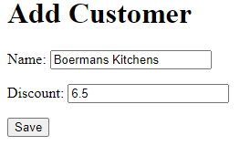
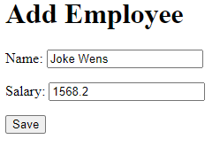
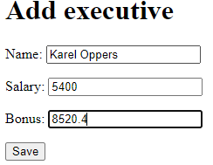
Testing SINGLE_TABLE inheritance strategy
We run the web app and add the following Customer, Employee and Executive:

Slide 24
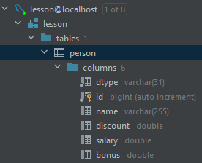
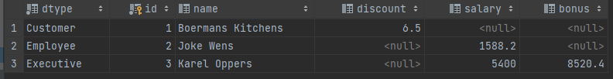
Result database SINGLE_TABLE inheritance strategy

Slide 25
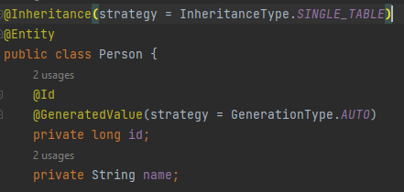
Explanation Strategy SINGLE_TABLE
SINGLE_TABLE is the default inheritance strategy. So if you do not indicate a strategy, by default the SINGLE_TABLE strategy will be used. The PERSON table will contain the following columns:
DTYPE: het discriminatortype waarmee
je kan herkennen welk soort object het is.
ID
NAME
DISCOUNT
SALARY
BONUS
  The columns correspond to all attributes of the superclass and all attributes of the subclasses + the column DTYPE.

Slide 26
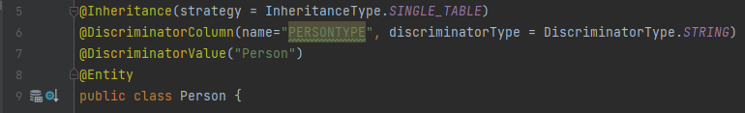
Strategy SINGLE_TABLE additional annotations
In addition to @Inheritance, additional annotations are possible to indicate how the objects in the database will be stored.
With the name attribute of the annotation @DiscriminatorColumn we can specify which name the column in which the discriminator type is tracked should be given (in this example PERSONTYPE).
Via the discriminatorType attribute, we can indicate how this type should be tracked (STRING, INTEGER or CHAR). (In this example STRING)
Through this discriminator column we can find out to which subclass the person in the given row belongs. The value that ends up in this column can be indicated with the annotation @DiscriminatorValue. You can also add this last annotation to each subclass
ATTENTION: this discriminator column is only needed at database level and may NOT be included as an attribute in the corresponding class. In this case, we do not create an attribute persontype in the person class. Every person object "knows" to which subclass it belongs. How you can request this we explain on slide 47.

Slide 27
Implementation SINGLE_TABLE additional annotations
Summary:
Additional Annotations in super class
Additional Annotations in subclass
NOTE: These annotations are not mandatory
  SINGLE_TABLE is the default strategy
  When no DiscriminatorColumn is indicated
  => discriminator column is named Dtype
  When no DicriminatorValue is indicated
  => discriminatorvalue = class name
@Inheritance(strategy = InheritanceType.SINGLE_TABLE)
@DiscriminatorColumn (name = "PERSONTYPE", discriminatorType = DiscriminatorType.STRING)
@DiscriminatorValue("PERSON")
@DiscriminatorValue("Klant")

Slide 28
Strategy SINGLE_TABLE
Advantages:
  The inheritance strategy SINGLE_TABLE gives the best performance because:
    No joins are needed to retrieve a person
    When writing a person object to the database, only 1 insert or update statement is required
Disadvantages:
  The table can become very wide with many null values
  This strategy presents problems in expanding the inheritance hierarchy.
    You can't just add columns to an existing table
      => more difficult to add subclasses (with attributes) to the hierarchy
      Adding an attribute to 1 subclass affects the table where ALL persons are stored
      If you make such a change, you will have to remove the table from the database and have it regenerated!

Slide 29
Strategy SINGLE_TABLE
Conclusion:
  The inheritance strategy SINGLE_TABLE is a good choice if:
    Objects within the hierarchy mainly differ in behavior (and not in properties)
    The classes within the hierarchy are stable (little chance of changes)
  The inheritance strategy SINGLE_TABLE is a bad choice if:
    Objects within the hierarchy have very different properties
    It is very likely that changes will be made to the hierarchy in the future.

Slide 30
Implementing inheritance:
JOINED

Slide 31
Implementing the example : Inheritance
The first example is ready!
We now make a second example where we apply the inheritance strategy JOINED instead of SINGLE TABLE
Copy the project you just created. In the following slides you will continue to work on this copy

Slide 32
Modify Person.java for inheritance strategy JOINED
We start from a copy of the example made to demonstrate the joined inheritance strategy.
To this end, we take the following steps:
Remove the newly created tables from the database
Adjust the annotations in the Person class as follows:
becomes
In the subclasses, we don't have to change anything.
@Inheritance(strategy = InheritanceType.SINGLE_TABLE)
@Entity
public class Person{
@Inheritance(strategy = InheritanceType.JOINED)
@Entity
public class Person{

Slide 33
Testing inheritance strategy JOINED
We are running the web app again and add the following Customer, Employee and Executive:

Slide 34
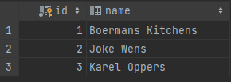
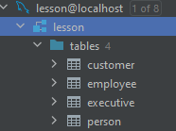



Strategy JOINED: result database
This inheritance strategy results in a table per class with the following characteristics:
The table PERSON contains the common attributes:
  ID
  NAME
Table CUSTOMER contains
  ID (foreign key to ID of superclass PERSON)
  Discount
Table EMPLOYEE contains
  ID (foreign key to ID of superclass PERSON)
  SALARY
Table EXECUTIVE contains
  ID (foreign key to ID of superclass EMPLOYEE)
  BONUS

Slide 35
Implementation JOINED
Summary:
Strategy JOINED must be declared mandatory for superclass.
No discriminator type and value needed (but allowed)
With the JOINED strategy, no Additional Annotations are required in the subclass (unless you want to specify a custom tableNAME)
@Inheritance(strategy = InheritanceType.JOINED)
@Entity
public class PERSON {
. . .
}
@Entity
public class Kaderlid extends EMPLOYEE {
. . .
}

Slide 36
Strategy JOINED
Advantages:
  The resulting tables do not contain redundant data
  When you want to add a subclass, this has no impact on the already existing tables
Disadvantages:
  Worse performance
    A child join is always needed to request information from a subclass
    Multiple INSERT or UPDATE statements are required to store an object of a subclass in the database
Conclusion:
  Good choice if:
    Subclasses have many unique attributes
    It is very likely that changes will still be made to the inheritance hierarchy.

Slide 37
Implementing Inheritance:
TABLE PER CLASS

Slide 38
Implementing the example : Inheritance
The second example is now also ready!
We are now making a third and final example where we apply the TABLE PER CLASS inheritance strategy.
Copy the project you just created. In the following slides you will continue to work on this copy

Slide 39
Change PERSON.java for inheritance strategy TABLE_PER_CLASS
We start from a copy of the example made to demonstrate the inheritance strategy TABLE PER CLASS.
To this end, we take the following steps:
Remove the newly created tables from the database
Adjust the annotations in the PERSON class as follows:
@Inheritance(strategy = InheritanceType.JOINED)
@Entity
public class PERSON{
@Id
@GeneratedValue(strategy = GenerationType.AUTO)
private long id;
becomes
@Inheritance(strategy = InheritanceType.TABLE_PER_CLASS)
@Entity
public class PERSON{
@Id
@GeneratedValue(strategy = GenerationType.TABLE)
private long id;
So we also adjust the autonumbering generation because GenerationType.AUTO cannot be combined with the Table Per Class inheritance strategy and Mysql.
In the subclasses we don't have to change anything

Slide 40
Testing TABLE_PER_CLASS inheritance strategy
We run the web app again and add the following Customer, Employee and Executive:

Slide 41
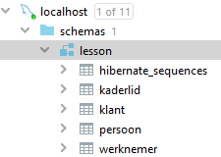




    Result database inheritance strategy TABLE_PER_CLASS
This inheritance strategy results in a table per class with a column for each attribute. In this example, the following tables:
  PERSON with ID, NAME
  CUSTOMER with ID, NAME, DISCOUNT
  EMPLOYEE with ID, NAME, SALARY
  EXECUTIVE with ID, NAME, SALARY, BONUS

Slide 42
Implementation TABLE_PER_CLASS
SUMMARY:
Strategy TABLE_PER_CLASS must be indicated to the superclass.
You also have to adjust the strategy of the autonumbering to GenerationType.TABLE if you work with MySQL
This strategy does not require additional annotations in the subclass
@Inheritance(strategy = InheritanceType.TABLE_PER_CLASS)
@Entity
public class PERSON{
@Id
@GeneratedValue(strategy = GenerationType.TABLE)
private long id;
@Entity
public class EXECUTIVE extends EMPLOYEE{
. . .
}

Slide 43
Strategy TABLE_PER_CLASS
Advantages:
  Better performance:
    no joins needed to query an object of a particular class
    In case of change only 1 insert or update statement is needed
Disadvantages:
  Many tables
  Sql "UNION ALL" needed to request all persons
Conclusion:
  Good choice if:
    It is very likely that changes will still be made to the inheritance hierarchy.
This strategy is usually unnecessary and is only supported by Hibernate

Slide 44
Implementing Inheritance:
POLYMORPHIC QUERIES

Slide 45
Polymorphic queries
A query returns all instances that meet a condition, including instances of subclasses:
select x from EMPLOYEE x where x.salary > 3500 returns EMPLOYEES but also all EXECUTIVES who meet this salary condition.
PERSONRepository.findAll() returns all Persons, including all CUSTOMERS, EMPLOYEES and EXECUTIVES

Slide 46
Polymorphic queries
Work this out in one of the 3 inheritance projects you have made for this (single table, joined or table per class). In the examples on canvas you can find this implementation in the "single table" project.
We now want to show all persons on the homepage. We first need to make sure that we have access to a list of all people and for this purpose, in PERSONController, adjust ANY method that refers to the index page so that it receives a list of people:
(…)
List<PERSON> list = PERSONRepository.findAll();
model.addAttribute("personlist", list);
return "index";
}
In index.html we add the following code to the body:
  <ol>
  <li th:each="PERSON : ${personlist}“><span th:text="${PERSON.getNAME()}"/> </li>
  </ol>

Slide 47
Polymorphic queries
We now want to further refine this list on the index page:
  With an EMPLOYEE we want to mention his SALARY
  With a CUSTOMER his DISCOUNT
  For an EXECUTIVE his BONUS
If you want to find out to which class an object belongs, you can check that by calling .class.simpleName on that object

Slide 48

Polymorphic queries
We adjust the code in index.html as follows:
  <ol>
  <li th:each="PERSON : ${personlist}"><span th:text="${PERSON.getNAME()}"/>
  <span th:if="${PERSON.class.simpleName == ‘Customer’}”
  th:text=“’gets ' + ${PERSON.getDiscount()} + ' Discount'" />
  <span th:if="${PERSON.class.simpleName == ‘Executive’}”
  th:text=“’has a bonus of ' + ${PERSON.getBonus()}" />
  <span th:if="${PERSON.class.simpleName == ‘Employee’}”
  th:text=“’earns ' + ${PERSON.getSalary()}" />
  </li>
  </ol>
Result:

Slide 49
@MappedSuperclass

Slide 50

@MappedSuperclass
What if the superclass of the inheritance tree is not an Entity (and therefore should not be tracked in the database)?
In that case, use the annotation @MappedSuperclass
This corresponds to an inheritance strategy SINGLE_TABLE applied to each of the subclasses of the PERSON class.

